Slide 1
Fake News detection on social media
180030192 – K.LIKHITHA
180031405 - Gayatri

Slide 2
OUTLINE :
1.ABSTRACT
2.INFORMATION
3.INTRODUCTION
4.PROJECT BACKGROUND
5.ANALYSIS
6.OBJECTIVE AND MODULES
7.SEQUENCE DIAGRAM
8. CONCLUSION AND FUTURE ENHANCEMENT

Slide 3
ABSTRACT
Vast Proliferation and exponential increase in use of social media networks has witnessed the growth of both true and fake news in the recent times. Social media networks such as Facebook, Instagram and Twitter are affected by this unhealthy practice of fake news. Blogs and micro blogs are also have been pouring this type of misinformation in a multitude manner. Texts, images, and videos filled with unwarranted matter and pumped to promote their selfish interests in an unethical manner. Lack of proper control mechanism facilitated this rise in the volume of fake news whcich ultimately has been creating confusion in the minds of receivers. In this unhealthy situation truth and facts are masqueraded leading to not just doubts about the bonafides but sometimes leading to chaos in the society.

Slide 4
To build healthy channels of information there is great need for fake news detection so that misinformation is cut and the public are protected from the menace. It is high time to develop techniques to identify and prevent the misinformation to enter into the society. The researchers identified the need to cleanse the Instagram platform by removing fake images and related texts as images are more powerful than mere texts and statistics show that more and more people prefer to watch visuals and images as it adds to the element of entertainment as well make people believe the serious information and news also. Real world techniques such as deep learning/ machine learning may be used to detect the fake news/ visual from making rounds creating an unhealthy news environment.

Slide 5
INFORMATION
Online Social Network (OSN) is a network hub where people interact with each other. Asthe popularity of OSN in increasing, fake news are creating problems to social network users. This Project is aim to develop a Automation model that will be able to detect and eliminate fake news and fake news spreaders from Online Social Networks and help to prevent the reach of fake news to the users in turn avoids panic situations among users. Fake news is the news which reaches out to the users like real news, when it is not true at all. In this project, a detection method has been proposed which can detect Fake information and posts in Online Social Networks (OSN). Fake News is detected based on set of rules that can effectively classify fake and genuine information. The detection process will be performed by a machine learning algorithm called as random forest algorithm

Slide 6
INTRODUCTION
This project is aimed at developing a system that detects fake news over the online social network sites and to delete that posts. OSN becomes the easiest way to broadcast media (news/content) over the Internet. The proposed model describes how misinformation gets disseminated among groups with the influence of different misinformation refuting measures. The model will be able to detect and eliminate fake news from OSNs and help ease some OSN users stress regarding the pandemic.

Slide 7
Project Background
This project paper is Defensive Modeling of Fake News through Online Social Networks mainly concentrates on the news or rumors that been spreading over the internet. Our system detects whether the news that have spreading through these online sites are genuine or not. And also one can delete the post of the fake news or rumor that is leading to misinformation on these online sites along with the accounts who posted it. By this system it is possible to eradicate fake news on the social media in the hard times of covid-19 by which makes people worry more over the fake news.

Slide 8
ANALYSIS
There are many users in the OSN with varying intentions. Few of them are spreading rumors in the network and others even may not be able to realize it. Therefore, to solve this, different types of methods are employed. One method is to block rumors, and another method is used to spread anti-rumors to diminish the effect of rumors, but this is a grueling affair. A hesitating mechanism-based SEIR model is proposed by Liu et al. for the study of rumor spreading in OSN. They used mean field theory for analysis of rumor spreading in OSN. They discussed the rumor-free equilibrium condition and global stability of the OSN and also obtained the value of basic reproduction number. They also analyzed the effects of feedback method on rumor spreading. They established the analysis feedback mechanism to reduce the rate of rumor spreading but were not able to reduce the value of basic reproduction number.

Slide 9
The blocking of rumor may create a reverse effect, as it makes the people more anxious to know more about it. Some other methods are used to block rumors and spread truth. In this method, first of all, the unwanted message is identified and then blocked as well as to spread the truth in OSN simultaneously. The social network is a scale-free network and learns rumor spreading in practical wisdom to design a heterogeneous epidemic model for the rumor dynamics.

Slide 10
Objectives
• To detect the fake news on online sites.
• To eliminate the posts who posts the fake news or rumor.
• To delete the accounts who poststhe misleading information.
• To provide genuine news to the public

Slide 11
MODULES
There are eight modules in our system. They are
❖ Data Collection
❖ Dataset
❖ Data Preparation
❖ Model Selection
❖ Analyze and Prediction
❖ Accuracy on test set
❖ Saving the Trained Model

Slide 12
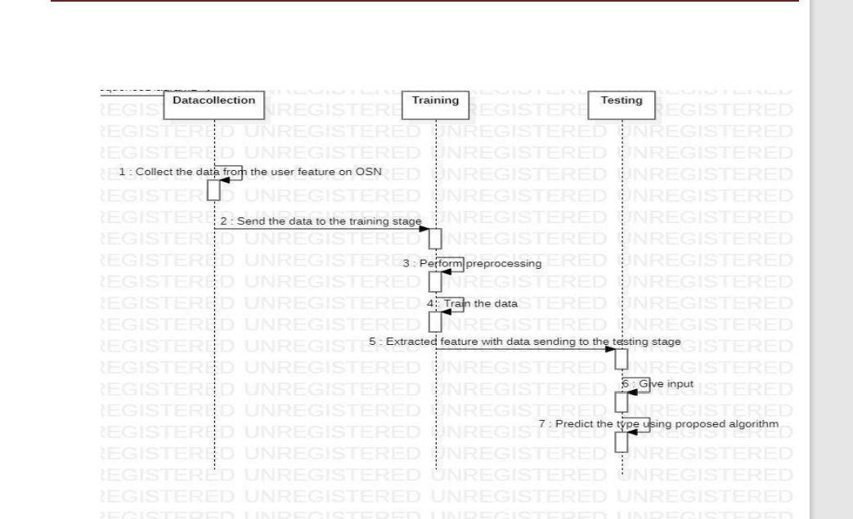
Sequence diagram

Slide 13
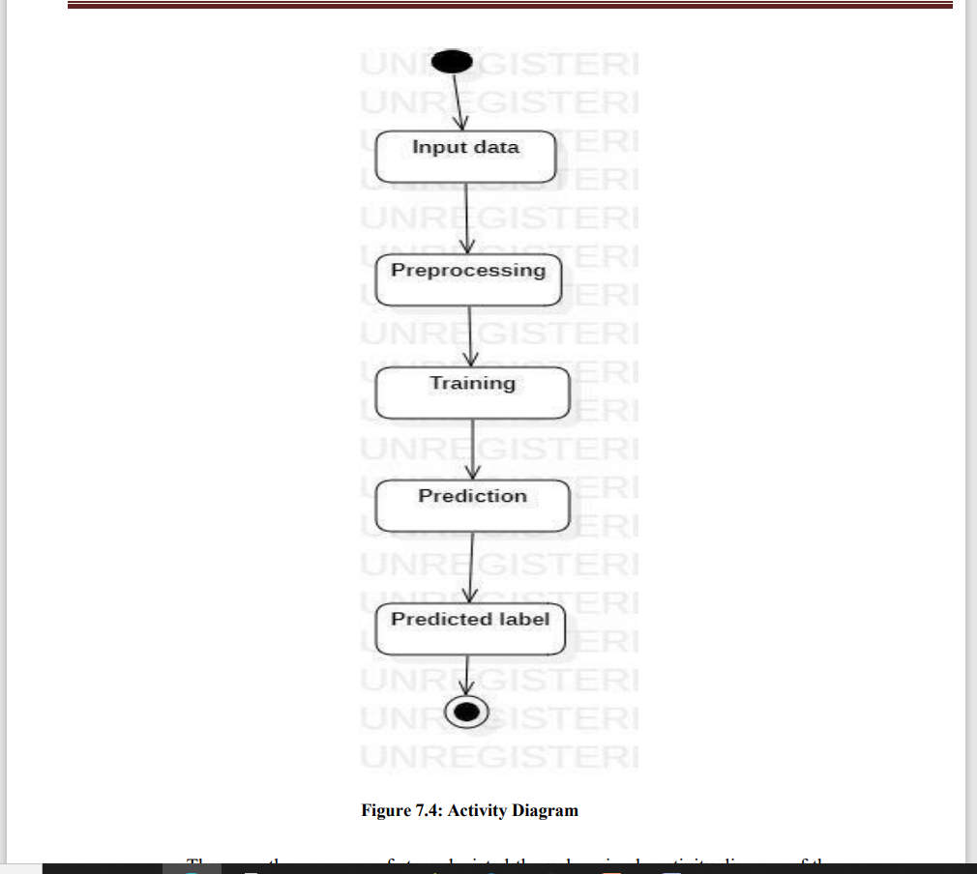

Slide 14
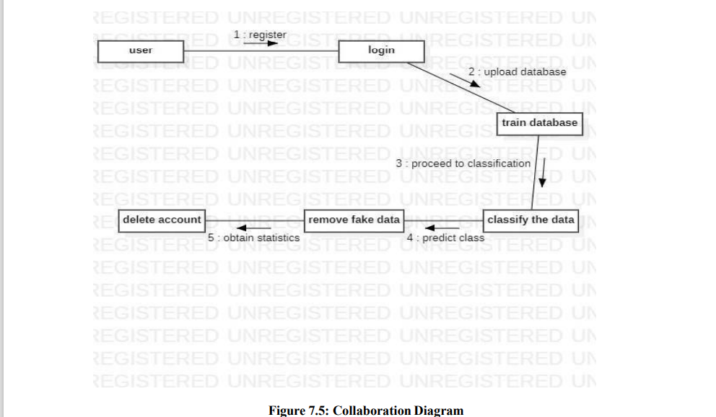

Slide 15
CONCLUSION AND FUTURE ENHANCEMENT
This Project is aim to develop an automation model that will be able to detect and eliminate fake news from Online Social Networks and help to prevent the reach of fake news to the users in turn avoids panic situations among users .With the rise of usage of OSNs, they have become means of information exchange. In such cases, information present in OSN is always not likely be true. As a result incorrect or fake news are spreading at rapid rate. They in turn affect lives of people in many ways. So it is very important to stop the reach of fake news among people in OSNs. The aim of this project is to detect the fake news and stop its spread to users of OSNs by eliminating it. Our proposed model aims at creating an automation model which can be embedded OSNs which detects every message which user wants to publish and if found fake, terminates it from OSN.

